Slide 1



PROJECT MANAGEMENT IN PRACTICE
Project Communications Management
Lecture No: 11 Week: 6
Vispi Shroff
Sub Heading
And Date

Slide 2

Recap
Definition of Project Quality Management & its relation to IT Projects
Quality Planning and relationship to scope management
Importance of Quality Assurance
Tools & Techniques for quality control

Slide 3
Today’s Topics & Learning Outcomes
- Importance of good communications in projects
- Stakeholders Identification and stakeholder management strategy
Elements of project communications planning
Create a communications management plan
Various methods for distributing project information and the advantages and disadvantages of each,
Importance of addressing individual communication needs,
Calculate the number of communications channels in a project

Slide 4
Importance of Good Communications
- The greatest threat to many projects is a failure to communicate.
- The IT culture does not portray IT professionals as being good communicators.
- Research shows that IT professionals must be able to communicate effectively to succeed in their positions.
- Strong verbal skills are a key factor in career advancement for IT professionals.

Slide 5
Communication Management Processes
Identifying stakeholders: identifying everyone involved in or affected by the project and determining the best ways to manage relationships with them
Planning communications: determining the information and communications needs of the stakeholders
Distributing information: making needed information available to project stakeholders in a timely manner
Managing stakeholder expectations: managing communications to satisfy the needs and expectations of project stakeholders and to resolve issues
Reporting performance: collecting and disseminating performance information, including status reports, progress measurement, and forecasting

Slide 6
Identify Stakeholders
- Ultimate goal of project management is to meet or exceed stakeholder needs and expectations from a project, so you must first identify who your particular project stakeholders are
-Two key outputs of this process include:
- Stakeholder register: a public document that includes details related to the identified project stakeholders
- Stakeholder management strategy: an approach to help increase the support of stakeholders throughout the project; often includes sensitive information

Slide 7
Planning Communications
- Every project should include some type of communications management plan, a document that guides project communications
- Creating a stakeholder analysis for project communications also aids in communications planning

Slide 8
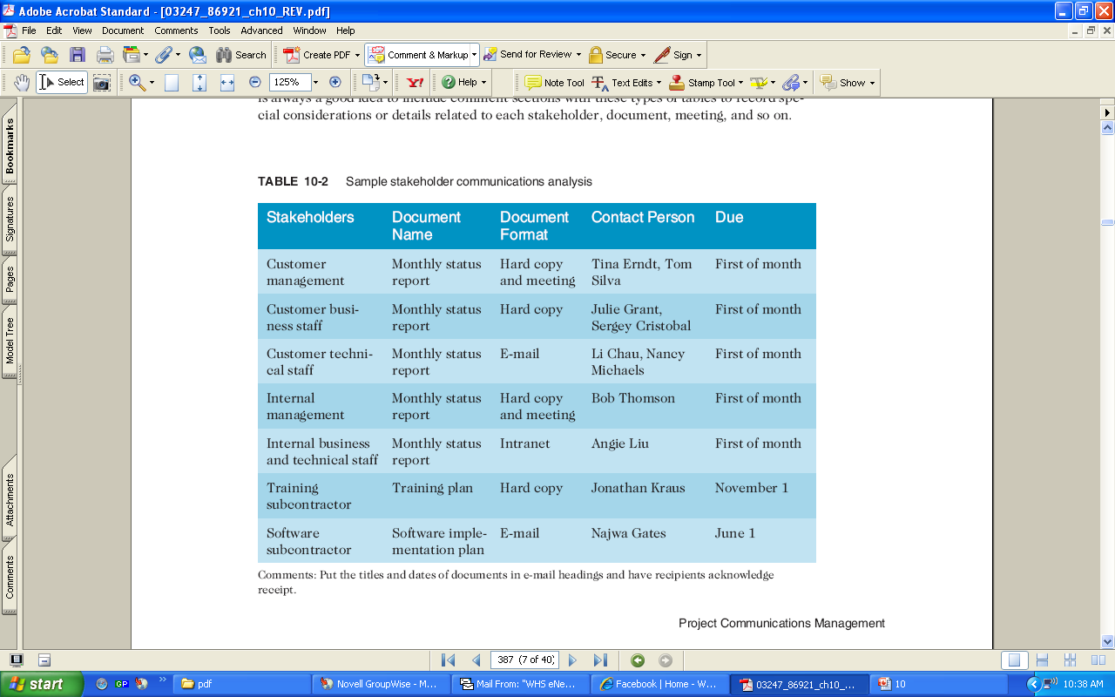
Sample Stakeholder Analysis

Slide 9
Comm. Management Plan Contents
Information to be communicated, including format, content, and level of detail
Stakeholder communications requirements
The people who will receive the information and who will produce it
Suggested methods or technologies for conveying the information
Frequency of communication
Escalation procedures for resolving issues
Revision procedures for updating the communications management plan
A glossary of common terminology

Slide 10
Distributing Information.. In a Timely & Effective Manner
- Getting the right information to the right people at the right time and in a useful format is just as important as developing the information in the first place
- Important considerations include:
- Using technology to enhance information distribution
Formal and informal methods for distributing information
Don’t bury crucial information
Don’t be afraid to report bad information
Oral communication via meetings and informal talks helps bring important information—good and bad—out into the open

Slide 11
Methods of Communication - Activity
- Types of Communication – Ex. Face-to-face
Modes of communication
Advantages
Disadvantages

Slide 12
Importance of Face-to-Face
- Research says that in a face-to-face interaction:
- 58 percent of communication is through body language
- 35 percent of communication is through how the words are said
- 7 percent of communication is through the content or words that are spoken
- Pay attention to more than just the actual words someone is saying
- A person’s tone of voice and body language say a lot about how he or she really feels

Slide 13
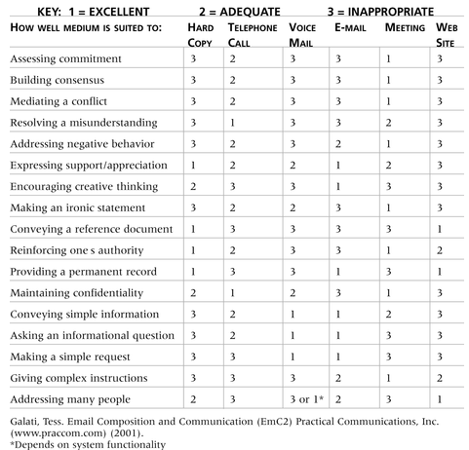
Media Choice Table

Slide 14
Communication Considerations
Group vs. Individual Communication Needs
Personal preferences affect communication needs
MBTI Personalities, introverts, extroverts, intuits, thinkers, judging & perceiving
Culture & Geographic Locations
Different working hours
Language barriers
Different cultural norms
Always provide perspective

Slide 15
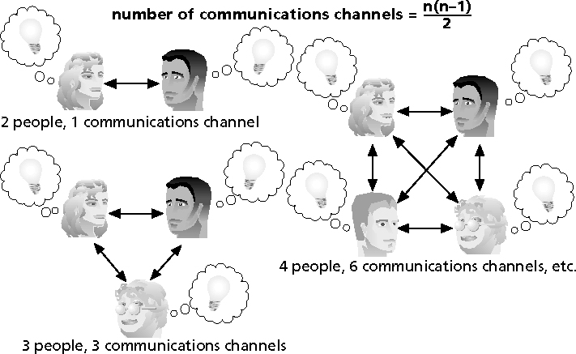
The number of channels of communication
Number of communications channels = n(n-1)/2

Slide 16
Managing Stakeholders
Project managers must understand and work with various stakeholders
Need to devise a way to identify and resolve issues
An expectations management matrix can help clarify expectations

Slide 17
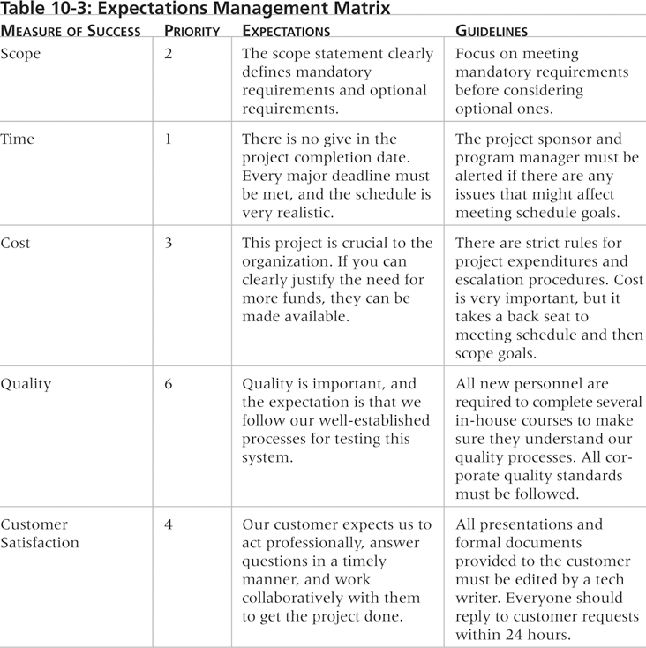
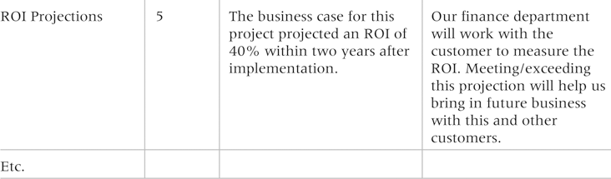
Expectations Management Matrix

Slide 18
Reporting Performance
Performance reporting keeps stakeholders informed about how resources are being used to achieve project objectives. Frequent performance reporting may go a long way towards managing stakeholder expectations:
Status reports describe where the project stands at a specific point in time
Progress reports describe what the project team has accomplished during a certain period of time
Forecasts predict future project status and progress based on past information and trends

Slide 19
Improving Communications
Manage conflicts effectively, but remember conflicts can be good.
- Develop better communication skills
- Run effective meetings
- Use e-mail and other technologies effectively
- Use templates

Slide 20
Conflict Handling Modes
Confrontation: directly face a conflict using a problem-solving approach
Compromise: use a give-and-take approach
Smoothing: de-emphasize areas of difference and emphasize areas of agreement
Forcing: the win-lose approach
Withdrawal: retreat or withdraw from an actual or potential disagreement
Collaborating: decision makers incorporate different viewpoints and insights to develop consensus and commitment

Slide 21
Conflict can be good
Conflict often produces important results, such as new ideas, better alternatives, and motivation to work harder and more collaboratively
Groupthink: conformance to the values or ethical standards of a group; groupthink can develop if there are no conflicting viewpoints
Research suggests that task-related conflict often improves team performance, but emotional conflict often depresses team performance

Slide 22
Developing Better Communication Skills
- Companies and formal degree programs for IT professionals often neglect the importance of speaking, writing, and listening skills
- As organizations become more global, they realize they must invest in ways to improve communication with people from different countries and cultures
- It takes leadership to improve communication

Slide 23
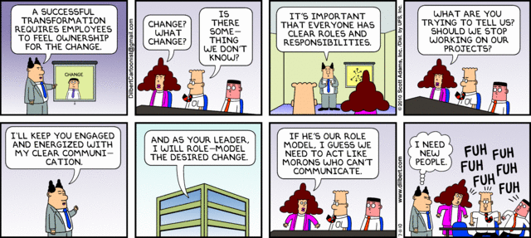
Any Thoughts, Questions, Ideas?

Slide 24
Reading Materials for the Week
Schwalbe, K., 2007. Information Technology Project Management 5th ed., United States of America: Thomson Course Technology. Chapter 11
PMBOK Guide – Chapter 11

Slide 25
Summary
We looked at a high level view of communications management within a project.

Slide 26
References
Schwalbe, K., 2007. Information Technology Project Management 5th ed., United States of America: Thomson Course Technology. Chapter 10
PMBOK Guide – Chapter 10
Dilbert Comics

